Slide 1
Scientific Programming Practical 1
Introduction
Luca Bianco - Academic Year 2017-18
luca.bianco@fmach.it

Slide 2
Outline
Personal introduction
Introduction to the practical
Hands-on practical

Slide 3
About me
Computer Science Ph.D. at the University of Verona, Italy, with thesis on Simulation of Biological Systems Research Fellow at Cranfield University - UK Three years at Cranfield University working at proteomics projects (GAPP, MRMaid, X-Tracker…) Module manager and lecturer in several courses of the MSc in Bioinformatics Bioinformatician at IASMA – FEM Currently bioinformatician in the Computational Biology Group at Istituto Agrario di San Michele all’Adige – Fondazione Edmund Mach, Trento, Italy

Slide 4

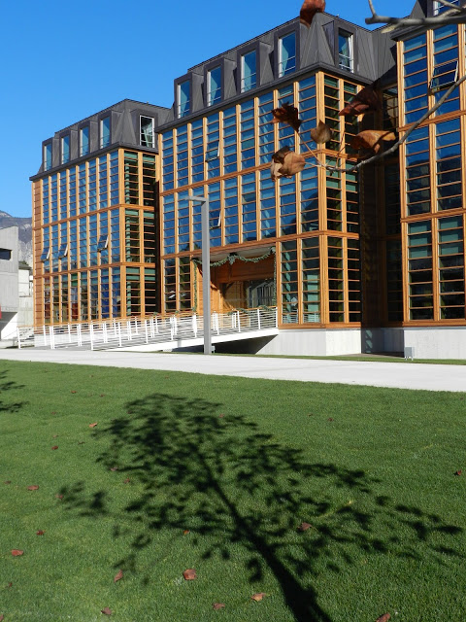
Fondazione Edmund Mach
Agricultural Institute Research and Innovation Centre Genomics, metabolomics wet labs on
fruits (apple, grape, small fruits,… ) Bioinformatics and computational biology

Slide 5
Bioinformatics @FEM (UBC)
Genomics
Assembly and annotation of complex genomes (plants, insects, etc.)
Development of SNP Chips for genetic screening
Resequencing of genomes
Metagenomics
Targeted metagenomic data
Feature selection algorithms
Algorithms for strain-level identification from un-targeted metagenomics
Transcriptomics
RNA-seq data analysis, gene and pathway enrichment
Data integration and compilation of expression atlases
Metabolomics
Data analysis pipelines for targeted and untargeted data
Methods for MS imaging
Statistical data analysis
Integration of –omic data and analysis of correlation networks

Slide 6
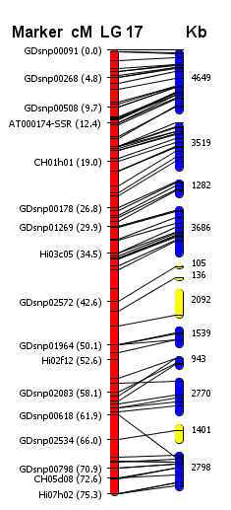
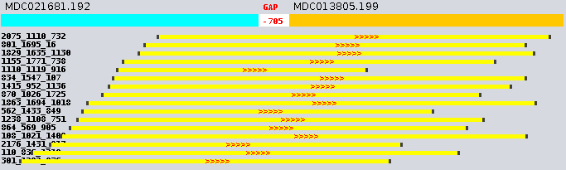
Bix @FEM -- Examples
Improving the Apple Assembly with SOLiD&Illumina data
Spatial relationships with long jump libraries (5K, 7.5K and 10K mate pairs)

Slide 7
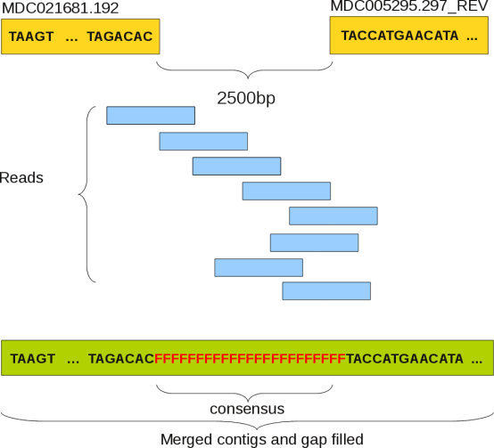
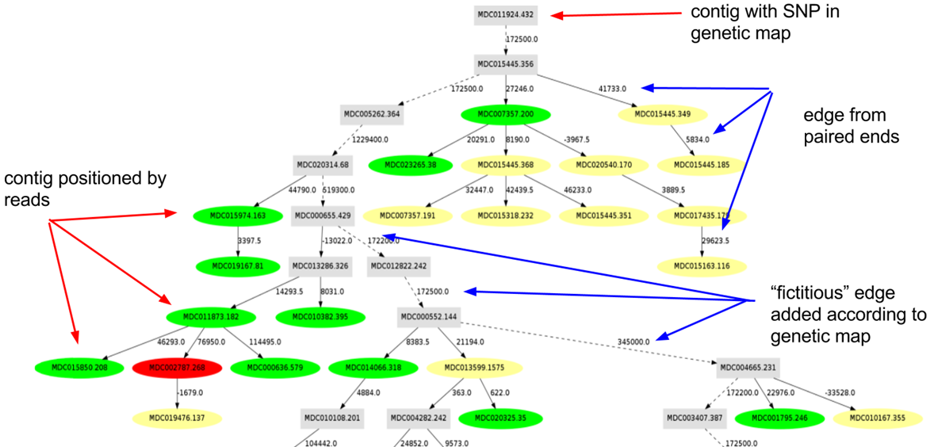
Bix @FEM -- Examples
Improving the Apple Assembly with SOLiD&Illumina data
Spatial relationships with long jump libraries (5K, 7.5K and 10K mate pairs)

Slide 8
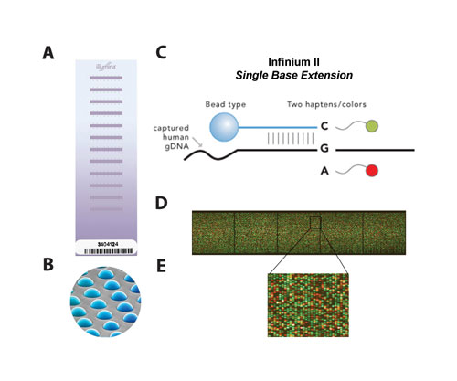
Bix @FEM -- Examples
SNP-Chips development for GWAS
20K SNP Illumina Infinium II Array (reseq of 16 Apple cultivars, Illumina 30x)
487K SNP Affymetrix Axiom Array (reseq of 63 Apple cultivars, Illumina 20-30x)
1. Reads alignment and filtering
2. SNP calling
3. Identification of most reliable SNPs
4. Selection of (20K) 487K target SNPs
Several Terabytes of data produced!!!!
Peach, pear and walnut done too!

Slide 9
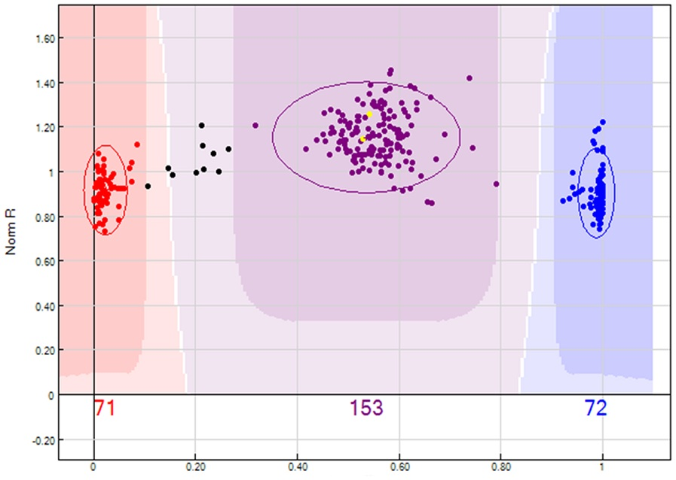
Bix @FEM -- Examples
SNP-Chips development for GWAS
20K SNP Illumina Infinium II Array (reseq of 16 Apple cultivars, Illumina 30x)
487K SNP Affymetrix Axiom Array (reseq of 63 Apple cultivars, Illumina 20-30x)
Task:
Analyze 500k of these…
(1 x SNP)
parents
genotypes
AA
AB
BB

Slide 10
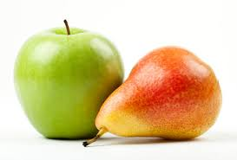
Bix @FEM -- Examples
Genome assembly of DH of Pear and Apple
Input data:
Illumina ~60x – 100x PE information + (mate pairs for Apple)
Pacific Biosciences ~ 30x + 30x (35x only for Apple)
Bionano optical maps: ~ 600x (for both)
Genetic maps: integrated genetic map from 21 mapping populations (Apple only)
Output result (for Apple, Pear is in progress):
Chromosome scale assembly
# Contigs: 2150 for a total of 625Mb
N50 Contigs (hybrid dbg2olc): ~ 620Kbps
280 Scaffolds, for an N50 5,6Mb
17 chromosomes + lg0 unanchored sequences
[Daccord et al, Nature Genetics, 49, 2017]

Slide 11
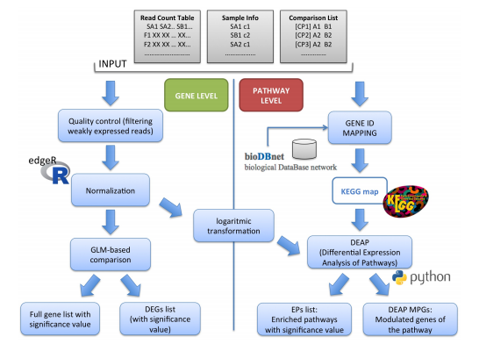
Bix @FEM -- Examples
RNAseq data analysis with Pathway Inspector
https://pathwayinspector.fmach.it

Slide 12
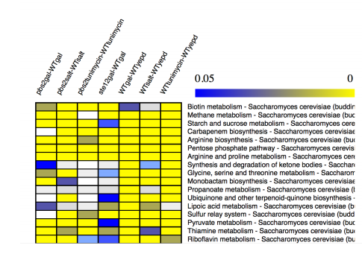
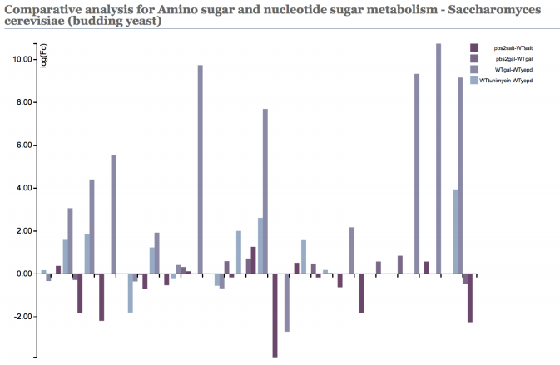
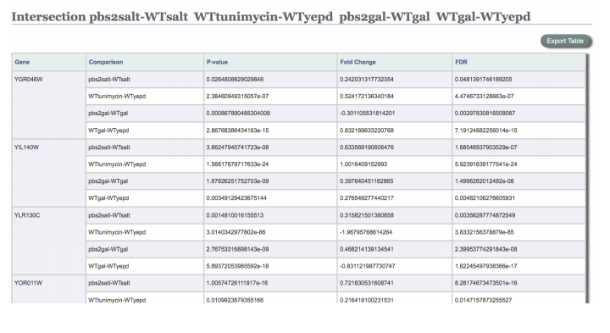
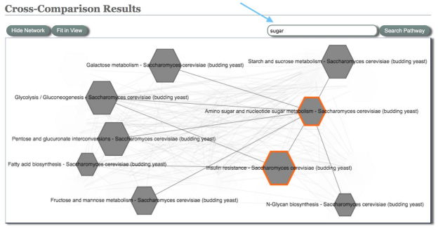
Bix @FEM -- Examples
RNAseq data analysis with Pathway Inspector
https://pathwayinspector.fmach.it

Slide 13

Opportunities @FEM
MSc External thesis
Are you interested in a bioinformatics project in NGS data analysis, RNA Seq, data integration?
Come and talk to me or email me at:
luca.bianco@fmach.it

Slide 14

Scientific Programming Practical
Back to business now!

Slide 15
Scientific Programming Practical
In this practical you will
Install Python 3.x (and pip)
Install Visual Studio Code
Get familiar with the Python console
Start using Visual Studio Code and advanced features (like debugging)
End the session with some exercises

Slide 16
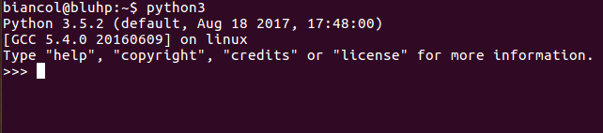
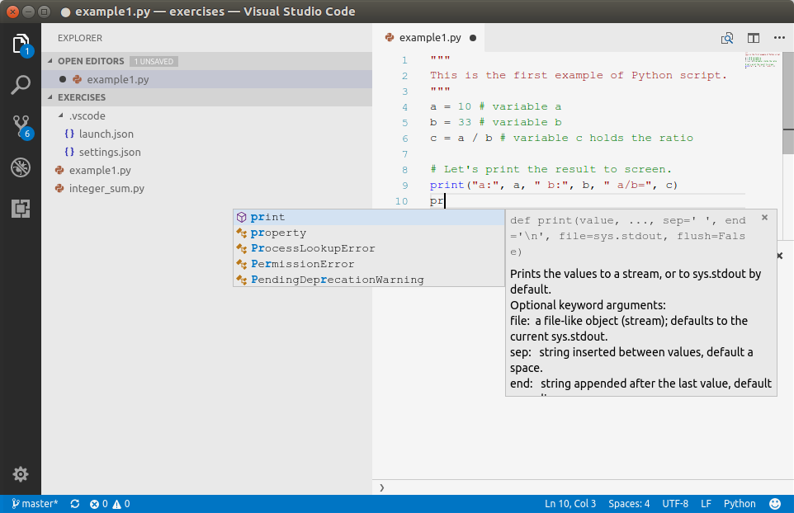
Scientific Programming Practical
Console VS. Integrated Development Environment (IDE)

Slide 17
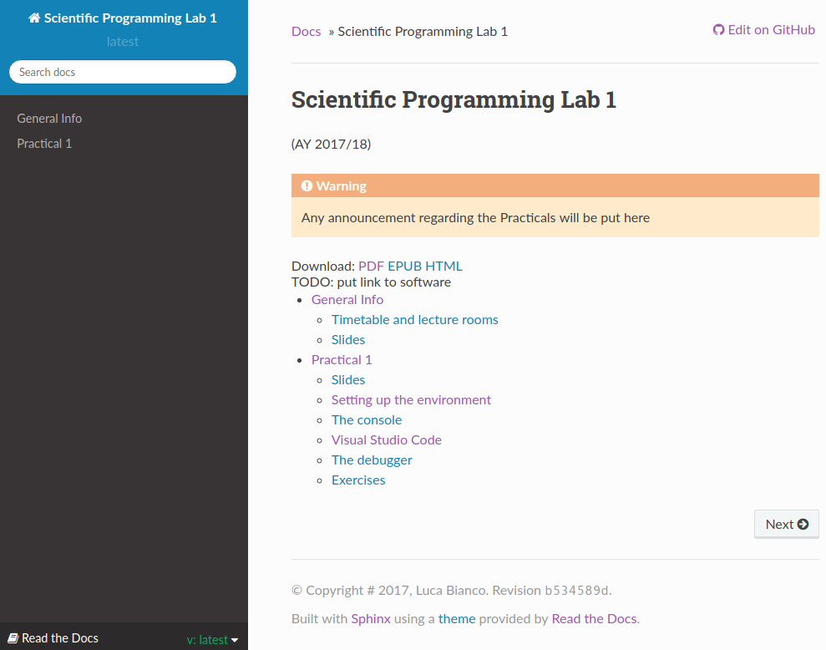
Resources
All material regarding practicals can be found here:
http://sciprolab1.readthedocs.io
@
luca.bianco@fmach.it

Slide 18
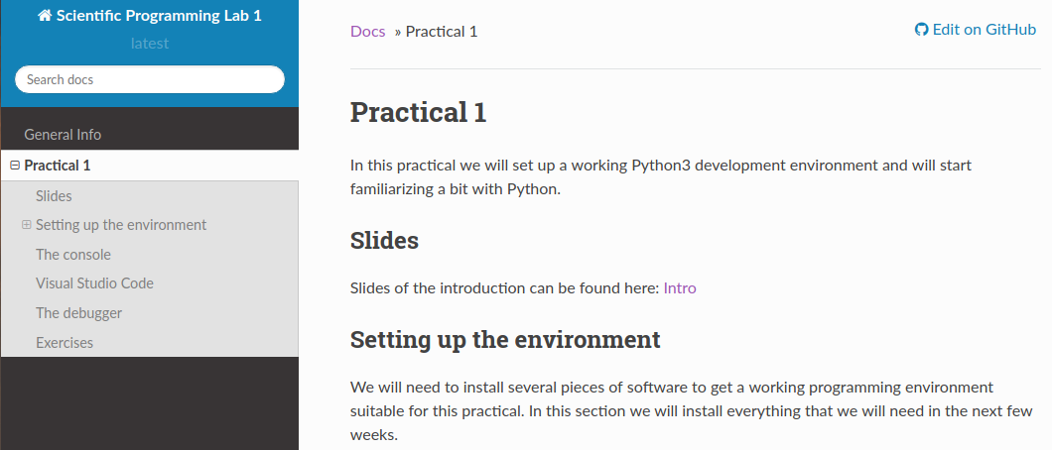
Any questions?
If not, go to:
http://sciprolab1.readthedocs.io/en/latest/introduction.html
@
luca.bianco@fmach.it

